Slide 1
MONGOLIAN AND POST-MONGOLIAN DYNASTIES IN CENTRAL ASIA
Cholpon CHOTAEVA
Anthropology, AUCA

Slide 2
Contents
Mongol Empire
Chaghatay Ulus
Qaydu State
Mogholistan
Empire of Timur
Conclusion

Slide 3
MONGOL EMPIRE (XIII-XIV)
Genghis Khan
Uniting Mongols
Conquests
Division of empire
Conquests of successors
Main facts

Slide 4
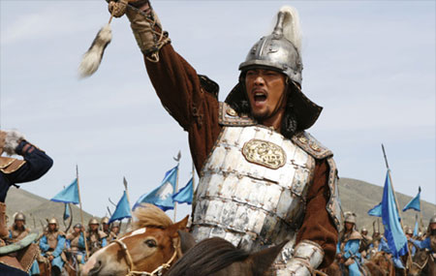
Genghis Khan
Born in 1162 (1167) in Borjigin clan, named Temujin (red-haired, green-eyed)
Father – Yesugei, a tribal chief
Mother – Hoelun
Three brothers, one sister
Wife – Borte
Four sons: Juchi,
Chaghatai, Ugedei,
Tolui
Died in 1227
(grave is unknown)

Slide 5
Uniting Mongols
Fragmented Mongol tribes:
Mongols, Naimans, Merkits, Tatars,
Keraits
Political climate of Mongolia: tribal warfare, thievery, raids, corruption
Enemies: Naimans – west
Merkits – north
Tatars – east
Friends: Keraits (Toghrul Khan), Jamuka
Announced Genghis Khan in 1206

Slide 6
Conquests
1207 – conquest of Yenisei Kyrgyzs
1209-1227 – conquest of Tanguts
1215 – conquest of Beijin, the capital of China
1218-1223 – conquest of Qarakhitay Kaganate
1220 – conquest of Khorezmia
1223 – conquest of the Caucasus,
defeat of Russia (Kalka River)

Slide 7
Conquests of successors
Ugedey (1230):
China
Russia and Ukraine (Batu 1238-1240)
Mongke (1251, a son of Tolui):
Iran, Iraq (Hulagu – Ilkhan dynasty)
Qubilai (1259, a son of Tolui):
China (Yuan dynasty)

Slide 8
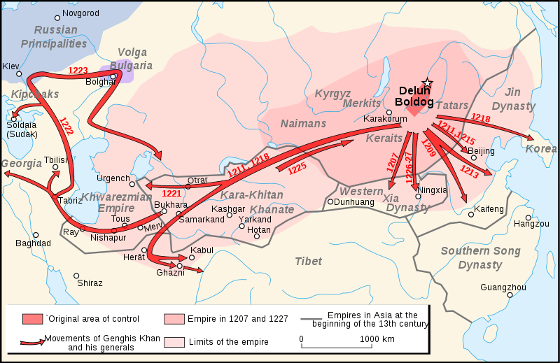
Mongol Empire under Genghis Khan

Slide 9
Division of Mongol Empire
Juchi:
Ordu (White Horde from Irtysh to
Ural River)
Batu (Golden Horde on Volga River)
Sheybani (Blue Horde from Tyumen
to Aral)
Chaghatay (Central Asia: Transoxania,
Semirechye, Western
Sinkiang)
Ugedey (Central Siberia and China)
Toluy (Mongolia)

Slide 10
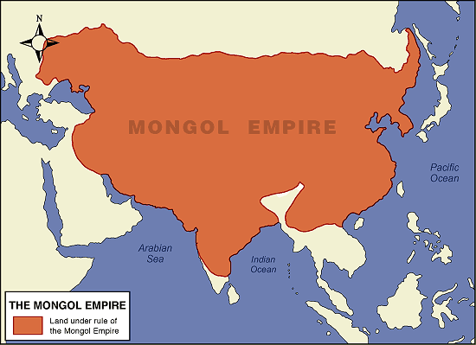
Mongol Empire under successors

Slide 11
Main Facts
Territory: from the Caspian Sea to the Japanese Sea
Capital: Karakorum, Beijing
Yassa – a civilian and military code
Religious tolerance: Buddhism, Islam, Christianity, Shamanism
Strong army based on meritocracy
Yam - the system of communications
Mongol written language (Secret History of Mongols)

Slide 12
CHAGHATAY ULUS (XIII-XIV)
Name: after Chaghatai, Chaghataids
Territory: Central Asia
Capital: Almaliq
Economy: nomadic pastoralism
Law: Yassa
Religion: Shamanism, Islam

Slide 13
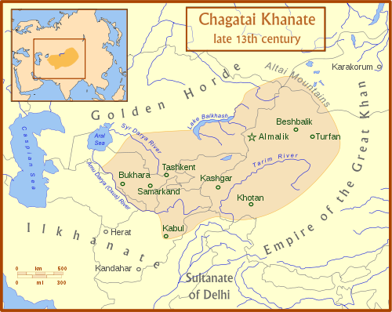

Slide 14
QAYDU STATE (XIV)
Name: after Qaydu, a grandson of Ugedey
Founder: Qaydu (1269-1303)
Territory: Chaghatai and Ugedey uluses
Capital: Tarsakent
Economy: pastoralism, agriculture, crafts, trade, money reform (golden and silver coins)
Enemy: Qubilai

Slide 15
MOGHOLISTAN (XIV-XVI)
Meaning: “State of Moghols”
Tribes: Duglats, Barlas, Baarin
Turkicized: language, culture, Islam
Territory: from Syr Darya – west
Irtysh River – east
Balkash Lake – north
Easern Turkestan – south
Capital: Ak Suu city (Ili Valley)

Slide 16
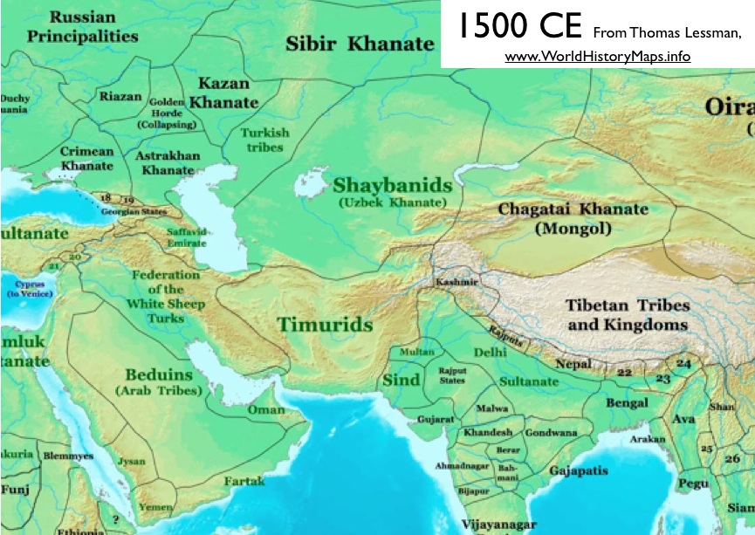

Slide 17
MOGHOLISTAN
Khan: Togluk Timur (18 years)
Ulusbek: Puladchi
International Relations:
1360-1361 - a military campaign to Mawarannahr
Kyrgyzs (XV): pagans, another dialect of Turkic, warlike people, Muhammad Kyrgyz

Slide 18
EMPIRE OF TIMUR (XIV-XVI)
Amir Timur
Conquests of Timur
Timur’s Empire
Timurids
Culture

Slide 19
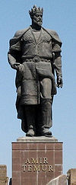
Amir Timur
Name: Timur, Tamerlane (Timurleng)
Birth: Born in 1336, Kesh city
Origin: Barlas tribe
Languages: Turkic, probably Persian
Wife: Tekina Mohbegim, a Genghisid princess
Children: four sons (Jahangir,
Umar Shaykh, Miranshah, Shahrukh)
Title: Amir (prince, ruler), Gurgan (son-in-law)
Died in 1405

Slide 20
Conquests
1395 – defeated Tokhtamysh, the ruler of the Golden Horde
1398 – defeated Mehmud, the sultan of Delhi (Northern India)
1402 – defeated Baesid I, the sultan of the Ottoman Empire

Slide 21
Empire of Timur
Territory: from the Caspian Sea to Northern India
Capital: Samarkand, Herat
Religion: Islam
Languages: Persian, Turkic, Arabic

Slide 22
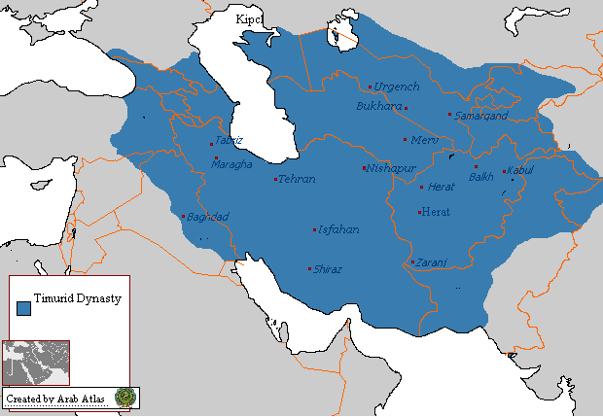
Empire of Timur

Slide 23
Timurids
Shahrukh - a son of Timur, Khorasan (capital – Herat)
Ulugh Bek - a grandson (Mawarannahr), a prominent scholar and astronomer
Baysunur - a grandson, Khorasan, a patron of arts
Babur – last of Timurids, Fergana, the founder of the Great Moghul Empire in India (1526)

Slide 24
Culture
Architecture: mosques, madrases, the astronomic observatory
Literature: Persian and Turkic poetry
Religion: Islam, Naqshbandi Sufi Order

Slide 25
Naqshbandi Sufi Order
Founded by Baha al-Din Naqshband
Born in Bukhara in 1318
A Persian in origin
Institutionalized Sufism
Sufi can live the life of an ordinary person
A silent zikr, individually
Most popular Sufi order in Central Asia

Slide 26
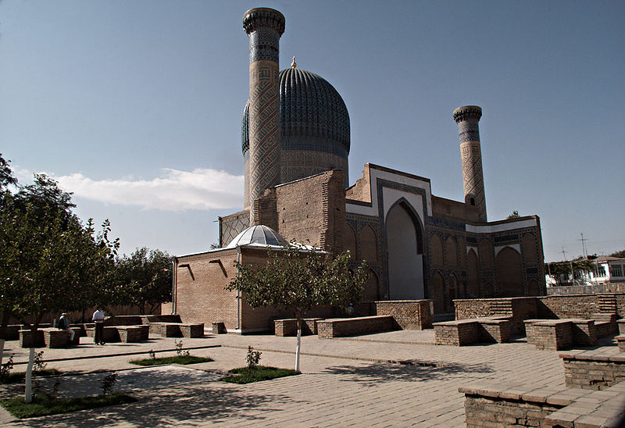
Gur-e Amir

Slide 27
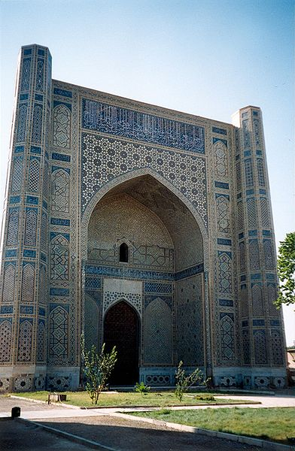
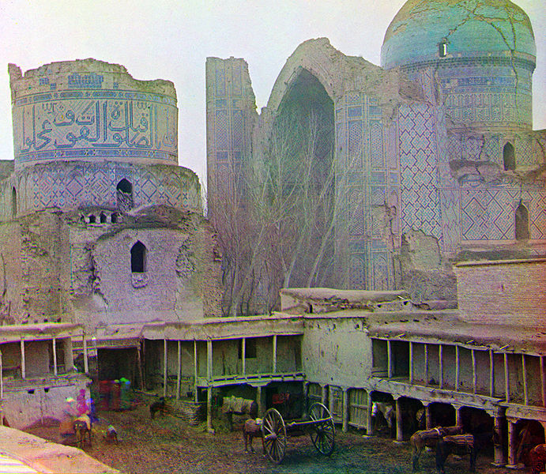
Bibi-Khanym Mosque

Slide 28
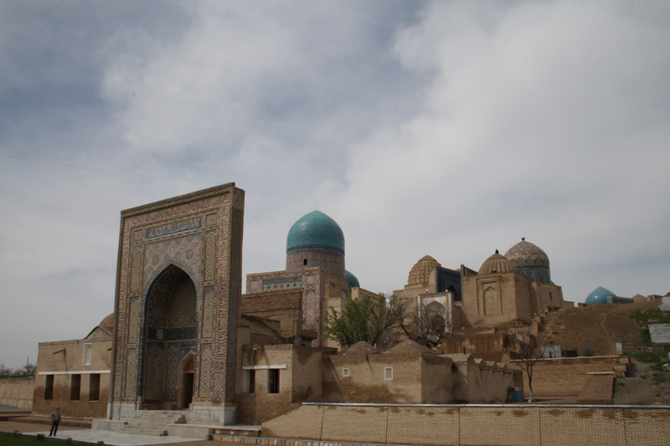
Shah-i-Zinda

Slide 29
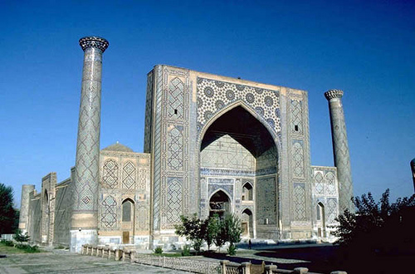
Ulugh Beg Madrasah

Slide 30
CONCLUSION
The Empire of Timur was smaller than Mongol empire
Timurid period was more glorious
Timur’s successors were less interested in conquests but rather encouraged the development of art and science

Slide 31
READINGS
Clavijo, Embassy to Tamerlane in 1403-1406, trans. Guy Le Strance

Slide 32
Midterm paper
Deadline 11 October (Fri) 6 pm
Criteria are in the e-course

